Slide 1
CHESS using MIN MAX

Slide 2

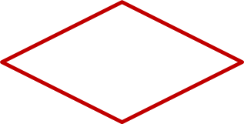

PLAYER SIDE
START
GAME MOVE
.
FALSE
IS LEGAL
TRUE
APPLY MOVE
CHECKMATE
END

Slide 3
End
False
True
True
Start
User’s move
Move is legal
Checkmate
False
False
Move Generator
END
Stale/checkmate
Move Evaluation
True
Best Move

Slide 4




BRUTE FORCE
we can build a Tree containing at least states.
A 2019’s computer has usually a multicore CPU with frequency is around 2 to 3 Ghz
processor is able to execute operations per second
In the ideal scenario our basic computer could execute
operations per second
our computer would need to work for:
searching through whole tree to find out what's our best move whenever we take turn would be super inefficient and slow.
Hence we cannot use the brute force strategy with the game of Chess!

Slide 5
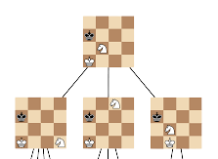
.
We'll define state-space complexity of the game as a number of legal game positions reachable from the starting position of the game, and branching factor as the number of children at each node
the nodes of the tree represent the different states of the board game. Hence, the height of the tree corresponds to the number of plies the algorithm will take into account before taking its decision.
For example, if we have a tree with a height of 5 then it means that our algorithm will analyze all the possible next 5 moves

Slide 6
CHESS and ADVersarial search
multi-agent environment
Each agent needs to consider the action of other agent and effect of that action on their performance.
Searches in which two or more players with conflicting goals are trying to explore the same search space for the solution, are called adversarial searches
Chess is deterministic
Chess is a zero-sum game → it is impossible for both players to win (or to lose).
Zero-sum games are games where the amount of "winnable goods" is fixed. Whatever is gained by one actor, is therefore lost by the other actor: the sum of gained and lost is zero. This corresponds to a situation of pure competition.

Slide 7
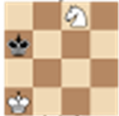
Formalization of the problem
Initial state : Board with all the pieces in their positions
Player(s) : It specifies which player has moved in the state space.
Action(s) : It returns the set of legal moves in state space.
Result(s, a) : It is the transition model, which specifies the result of moves in the state space.
Terminal-Test(s) : Terminal test is true if the game is over, else it is false at any case. The state where the game ends is called terminal states.
Utility(s, p) : For Chess, the outcomes are a win, loss, or draw and its payoff values are +1, 0, ½.
.

Slide 8
MIN MAX
The algorithm incorporates three basic functions: Maximize and Minimize, as well as a Utility Calculation function
The premise of the algorithm is that the computer will calculate its next best move by evaluating the utility of the board several turns down the road. In doing so, the computer assumes that the opponent always selects the best move, minimizing the utility for the computer
Once it reaches a terminal node or depth limit, the Utility Calculation function is called, and a resulting utility value for that particular terminal board is calculated.
This utility value is then “passed up” to the parent node where it is compared to the current utility value at the parent (if assigned yet). If the parent node is in a Maximize cycle, the terminal node utility value replaces the utility at the parent node if it is greater than the current value at the parent node or the parent node has yet to be assigned a utility value.
The converse would be true if the parent node were in the Minimize cycle.

Slide 9
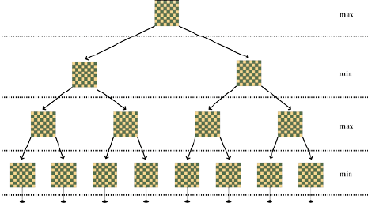
.
The algorithm is recursive in that Maximize calls Minimize, and Minimize calls Maximize.
We have conditions that break us out of the recursive loop. This would happen if, for instance, we reach a node in our search space where someone has won the game, the board is full, or perhaps most commonly, we have reached the pre-determined depth limit.
How utility is calculated is entirely up to the programmer. It can incorporate a large variety of factors and weigh them as the programmer sees fit.
For instance, number of blank spaces on the board, the location of the opponent’s current pieces, the location of our current pieces, how close we are to a winning formation, etc. all might be factors to consider in calculating the utility of a particular move.
.

Slide 10
ALGORITHM
int minimax(int depth, int nodeIndex, bool isMax,
int scores[], int h)
{
if (depth == h)
return scores[nodeIndex];
if (isMax)
return max(minimax(depth+1, nodeIndex*2, false, scores, h),
minimax(depth+1, nodeIndex*2 + 1, false, scores, h));
else
return min(minimax(depth+1, nodeIndex*2, true, scores, h),
minimax(depth+1, nodeIndex*2 + 1, true, scores, h));
}
Time complexity : O(b^d).
Space Complexity : O(bd)

Slide 11



MIN MAX VS ALPHA BETA PRUNING
It has been estimated that the depth of the chess game is 80
And , it has been estimated that the branching factor of the game of Chess is 35
The branching factor allows us computing the number of states we need to expand to be able to anticipate the N next moves. The formula is simple : 35^N.
For example:
.
possible moves
possibilities if we try to anticipate the moves up to 2 steps in advance
Possibilities if we try to anticipate the moves up to 6 steps in advance

Slide 12

Hence, if we use the minimax algorithm we could look ahead only about 6 plies because a common CPU has a frequency around
That means that the minimax algorithm will take roughly 2 seconds to determine the best next move to execute by analyzing all the possibilities 6 plies ahead.
So that means that with our minimax algorithm, and if we are using a common computer, our “Artificial Intelligence” takes 1 minute at each step to decide which action to choose by computing all the possible outcomes 6 plies in advance.
by using the alpha-beta pruning technique, we can build an “Artificial Intelligence” capable of seeing 10 to 11 steps ahead

Slide 13
Alpha beta pruning
int minimax(int depth, int nodeIndex,bool maximizingPlayer,int values[], int alpha,int beta)
{
if (depth == reached)
return values[nodeIndex];
if (maximizingPlayer){
int best = MIN;
for (int i = 0; i < 2; i++){
int val = minimax(depth + 1, nodeIndex * 2 + i false, values, alpha, beta);
best = max(best, val);
alpha = max(alpha, best);
if (beta <= alpha)
break;
}
return best;
}
else
{
int best = MAX;
for (int i = 0; i < 2; i++)
{
int val = minimax(depth + 1, nodeIndex * 2 + i,
true, values, alpha, beta);
best = min(best, val);
beta = min(beta, best);
// Alpha Beta Pruning
if (beta <= alpha)
break;
}
return best;
}
.
Alpha: It is the best choice so far for the player MAX. We want to get the highest possible value here. Beta: It is the best choice so far for MIN

